Slide 1

Calculating Churn Rates
Analyze Data with SQL
Petru Apachitei
Date: 08-09-2020

Slide 2
Example Table of Contents
Introduction of the project
Churn rate
3.. Compare churn rate between user segments and further insights

Slide 3
1. Introduction of the project

Slide 4
1.1 Introduction
What is the churn rate?
For SAS companies churn rate is a business metric for measuring how good your product is doing and refers to customers who have lost over a period of time.
How we calculate churn rate?
For this type of business the churn rate is calculated by the following mathematical ratio between number of users who canceled the subscription in a given time period divided by the total active users at the beginning of that period
What is helpful churn rate?
See how your product is performing
See the health of your product, why people are leaving, first step to diagnose why a product is doing well or not.

Slide 5
1.2 Company and dataset introduction
Company
Codeflix, a streaming video startup, is interested in measuring the churn rate between two segments of users. Codeflix requires a minimum of subscriptions length of 31 days.
Dataset
Dataset provided contain four columns, due to the minimum subscription length of 31 days, there are 3 months for churn calculation
Codeflix running ad campaigns and create A/B test, segmenting users by two landing page.
-- get familiar with the dataset.
SELECT *
FROM subscriptions
LIMIT 100;
-- extract from dataset the range of months data provided
SELECT
strftime('%m', subscription_end) as 'month',
MIN(subscription_end) as first_day,
MAX(subscription_end) as last_day
FROM subscriptions
WHERE subscription_end IS NOT NULL
GROUP BY 1;
-- create a query to display users segments
SELECT
segment,
COUNT(*)
FROM subscriptions
GROUP BY 1;
Subscribtion channel | Number of users
30 | 1000
87 | 1000
Dataset time period
2017-01-01 2017-01-31
2017-02-01 2017-02-28
2017-03-01 2017-03-31

Slide 6
2. Churn rate

Slide 7
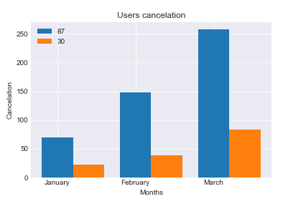
2. 1 Calculate the users who cancel the subscription
Calculate the users who left Codeflix for the time period provided by the dataset.
The related query is attached under Appendix 1.
Month | Left_segment_87 | Left_segment_30
January | 70 | 22
February | 148 | 38
March | 258 | 84

Slide 8
3. Compare churn rate between user segments and further insights

Slide 9
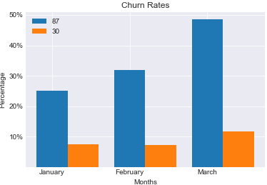
3. 1 Calculate customer churn
Calculate churn rate for segment 87 and 30 for the three months period.
January segment 87: 25% & segment 30 : 8%
January segment 87: 32% & segment 30 : 7%
January segment 87: 49% & segment 30 : 12%
The related query is attached under Appendix 1.
Month | Churn_rate_segment_87(%) | Churn_rate_segment_30(%)
January | 25.2 | 7.6
February | 32.0 | 7.3
March | 48.6 | 11.7

Slide 10
3.2 Conclusion
From the calculation results user from segment 87 has higher churn rate than segment 30, means that segment 30 has better performance.
What can we do for segment 87?
Why are they leaving?
Go out and enggage with customers, talk to them, look at their proffile, identify characteristics and analyze past interactions with the product.
What action can we derive from the results?
Call customers who left and ask them for feedback, communicate to them the latest developments that might be in their interest. This approach will create a felling of customers needs and perspective of your product. Preferable is calling and talk to them rather than send him to fill in a survey.
Which features have the most impact on a customer leaving?
This question should be addressed to customer support team.

Slide 11
Appendix 1
CASE
WHEN segment = 87
AND (
subscription_start < first_day AND
((subscription_end IS NULL) OR (subscription_end > first_day))
)THEN 1
ELSE 0
END AS is_active_87,
CASE
WHEN segment = 30
AND (
subscription_start < first_day AND
((subscription_end IS NULL) OR (subscription_end > first_day))
)THEN 1
ELSE 0
END AS is_active_30,
CASE
WHEN segment = 87
AND (
subscription_end BETWEEN first_day AND last_day
) THEN 1
ELSE 0
END AS is_canceled_87,
CASE
WHEN segment = 30
AND (
subscription_end BETWEEN first_day AND last_day
) THEN 1
ELSE 0
END AS is_canceled_30
FROM cross_join),
- create a temporary table of months.
WITH months as
(SELECT
'2017-01-01' as first_day,
'2017-01-31' as last_day
UNION
SELECT
'2017-02-01' as first_day,
'2017-02-28' as last_day
UNION
SELECT
'2017-03-01' as first_day,
'2017-03-31' as last_day
FROM subscriptions),
-- Create a temporary table, cross_join, from subscriptions and your months
cross_join as
(SELECT *
FROM subscriptions
CROSS JOIN months
),
-- Create a temporary table, status, from the cross_join table
status as
(SELECT
segment,
id,
first_day as month,

Slide 12
Appendix 1
-- Create a status_aggregate temporary table that is a SUM of the active and canceled subscriptions for each segment, for each month
status_aggregate as
(SELECT
month,
SUM(is_active_87) as sum_active_87,
SUM(is_active_30) as sum_active_30,
SUM(is_canceled_87) as sum_canceled_87,
SUM(is_canceled_30) as sum_canceled_30
FROM status
GROUP BY 1)
- Calculate the churn rates for the two segments over the three month period.
SELECT month,
ROUND (100.0 * (sum_canceled_87) / (sum_active_87), 1) as churn_rate_87,
ROUND (100.0 * (sum_canceled_30) / (sum_active_30), 1) as churn_rate_30
FROM status_aggregate;

